Slide 1
AVL TREE
Pointer to Pointer Implementation

Slide 2
AVL Tree: Balanced Binary Search Tree
13
AVL Balance Property
At every node X, the height of the left subtree differs from the height of the right subtree by at most 1.
10
18
5
11
14
4

Slide 3
AVL TREE (PPI) OPERATIONS
Operations supported by AVL Tree Pointer to Pointer Implementation
Search-AVL
insert-AVL
delete-AVL

Slide 4
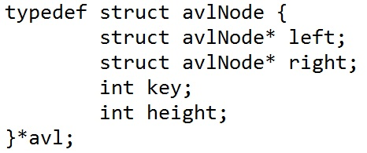
STRUCTURE DEFINITION + ILLUSTRATION
avlNode
key
height
L
R

Slide 5
Operation: searchAvl(T, 5)
T
13
3
5 exists in the tree!
●
●
10
18
2
2
● ●
● ●
5
11
14
1
1
1
● ●
● ●
● ●

Slide 6
Operation: insertAVL(*T , 13)

Slide 7
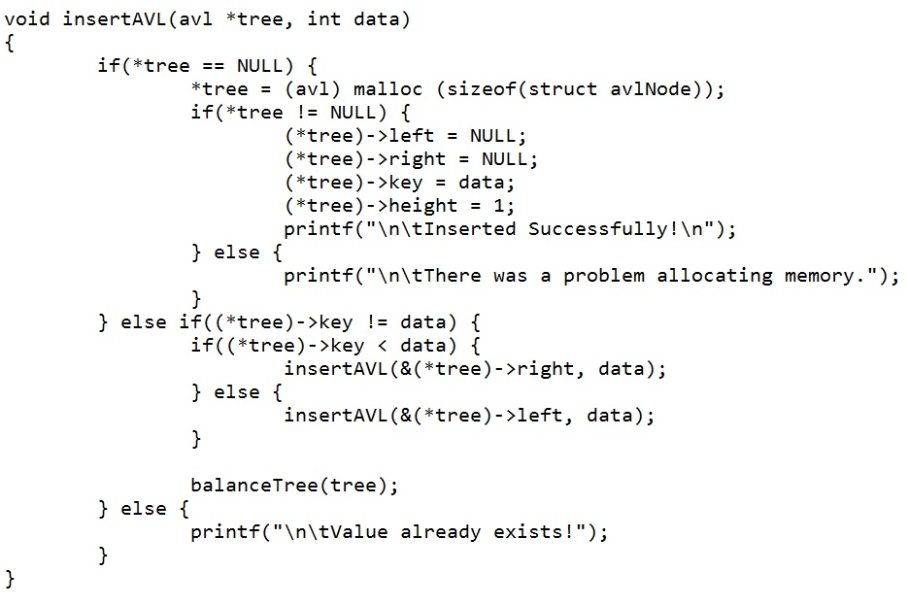
Operation: insertAVL(*T , 13)
T
13
1
●
●

Slide 8
Operation: insertAVL(*T , 10)

Slide 9
Operation: insertAVL(*T , 10)
T
13
2
1
●
●
10
1
● ●

Slide 10
Operation: insertAVL(*T , 18)

Slide 11
Operation: insertAVL(*T , 18)
T
13
2
●
●
10
18
1
1
● ●
● ●

Slide 12
Operation: insertAVL(*T , 14)

Slide 13
Operation: insertAVL(*T , 14)
T
13
2
3
●
●
10
18
1
1
2
● ●
● ●
14
1
● ●

Slide 14
T
13
Operation: insertAVL(*T , 15)
3
●
●
10
18
1
1
3
● ●
● ●
14
2
1
● ●
15
1
● ●

Slide 15
T
13
Operation: insertAVL(*T , 15)
3
●
●
10
18
1
3
● ●
● ●
14
2
● ●
15
1
● ●

Slide 16
T
13
Operation: rotateAvl(*r, state)
3
●
●
10
18
1
3
oldRoot = *root
● ●
● ●
14
newRoot
2
● ●
15
oldMiddle
1
● ●

Slide 17
T
13
Operation: rotateAvl(*R, state)
3
●
●
10
18
1
3
● ●
● ●
oldRoot
14
newRoot
2
● ●
15
oldMiddle
1
● ●

Slide 18
T
13
Operation: rotateAvl(*R, state)
oldRoot = *root
3
●
●
10
18
1
3
● ●
● ●
newRoot
15
2
● ●
oldMiddle
14
1
● ●

Slide 19
T
13
Operation: rotateAvl(*R, state)
*root = oldRoot
3
●
●
10
18
1
3
● ●
● ●
newRoot
15
2
● ●
oldMiddle
14
1
● ●

Slide 20
T
13
Operation: rotateAvl(*R, state)
3
●
●
10
15
1
2
● ●
● ●
14
18
1
1
● ●
● ●

Slide 21
Operation: deleteMin(*T)

Slide 22
T
Operation: deleteMin(*T)
13
3
●
●
oldRoot = *tree
10
15
2
2
● ●
● ●
5
14
18
1
1
1
● ●
● ●
● ●

Slide 23
T
Operation: deleteMin(*T)
13
3
●
●
10
15
1
2
2
● ●
● ●
14
18
1
1
● ●
● ●

Slide 24
T
Operation: deleteMin(*T)
13
3
●
●
10
15
1
2
● ●
● ●
14
18
1
1
● ●
● ●

Slide 25
Operation: deleteAVL(*T , 15)

Slide 26
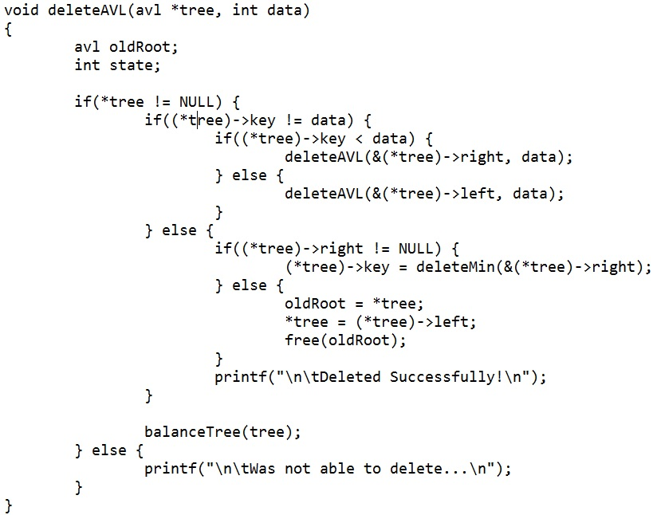
Operation: deleteAVL(*T , 15)
T
13
3
●
●
10
15
1
2
● ●
● ●
14
18
1
1
● ●
● ●

Slide 27
Operation: deleteAVL(*T , 15)
T
13
3
●
●
10
14
1
2
● ●
● ●
18
1
● ●

Slide 28
Operation: deleteAVL(*T , 13)

Slide 29
Operation: deleteAVL(*T , 13)
T
13
3
●
●
10
14
1
2
● ●
● ●
18
1
● ●

Slide 30
Operation: deleteAVL(*T , 13)
T
10
3
●
●
14
2
● ●
18
1
● ●

Slide 31
Operation: deleteAVL(*T , 13)
T
14
2
● ●
10
18
1
1
●
●
● ●

Slide 32
E N D

